Slide 1
application
data service
framework
Graphic design / svetagraphics.com
01

Slide 2
some of the problems we are trying to solve
data source switch
multiple data sources
ETL
02

Slide 3
SQL code re-usability
R1.GET_PATIENT_DEMO
- get data
- format for R1
CODE NOT RE-USED
Some reasons for not re-using the code
Wrong sort order
Wrong format (concatenations, ets)
Developer unaware that code already exist.
R2.GET_PATIENT_DEMO
- get data
- format for R2
03

Slide 4
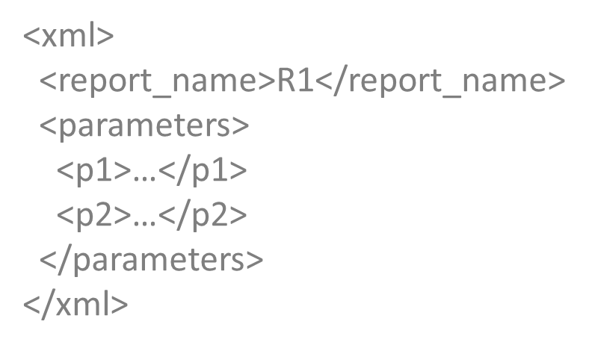
solution overview
solution objectives
input
Separation of labor between database and application development (app developers are not burdened with understanding of database nuances).
All data base logic/code resides in the database.
Reusability of SQL code
Ease of tracing and tuning.
Ease of dispatching to appropriate data source.
Metadata-driven dispatch.
<xml>
<DataSection1>
<element1>…</element1>
<element2>…</element2>
</DataSection1>
<DataSection2>
<element1>…</element1>
<element2>…</element2>
</DataSection2>
</xml>
return
to App
output
All application data requests are sent to one place – GET_MY_DATA function.
The function accepts XML document that contains the description of the data requested (App Module Name) and the list of required parameters.
It is the job of this function to figure out what SQL against what sources should be executed.
The output of the function is an XML document that contains all data that the App needs, formatted so it can be easily mapped.
04

Slide 5
implementations details
Application
Data Page Assembler
Data Library
Data Sources
Dispatch
TFN_R1
Assemble complete R1
data set using library and
custom components
Operational
Metadata
TFN_DL_1
TFN_R2
Assemble complete R2
data set using library and
custom components
TFN_DL_2
CUSTOM DATA SET
Application submits a request for a Data Page to GET_MY_DATA function. A Data Page is a collection of data sets required to perform an application function. For example, header and detail data sets used to render a report.
Using parameters in Input XML and Operational Metadata, GET_MY_DATA dispatches the call to the corresponding Data Page Assembler program.
Data Page Assembler is a set of programs specific to a particular Data Page. It executes the workflow to collect all required data sets and packages them in a single Output XML document. The Assembler requests relational data sets from Library and/or Custom programs. It may filter, join, sort, and format returned data sets.
Data Library contains table functions that return relational data sets that are expected to be re-usable by multiple application modules. They are tuned for re-usability and performance, and are parameterized for data source selection and scope.
Custom programs return relational data sets that are not expected to be re-used. They can be coded within the Data Page Assembler.
All external Data Sources are DBLinked to the hosting Oracle database.
05

